Slide 1

computers
Gwen & Hannah

Slide 2



Agenda
Introduction – (what is this all about)
Getting Started – (what research did you do)
Interview Description – (who was the user, what are their needs)
Selection – (explain a few considerations)
Justification – (why does this fit the users needs)

Slide 3
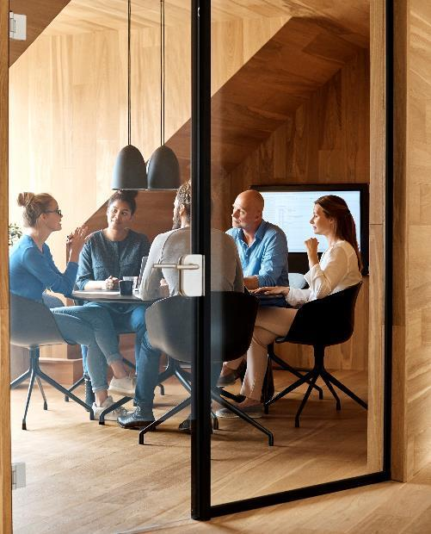



Introduction
This topic is all about researching computers and their parts we researched a desktop pc, laptop pc, desktop mac and mac book. And went and intervied someone and asked them questions like how often do you use your computer? And then asked them what they used it for. Then gave them a few options to choose from that they thought would best suit them.

Slide 4

Getting Started
I researched 4 different types of computers a Mac book, Mac desktop, desktop PC and a Laptop PC. that my dad could choose from and what componites that they have inside of them Eg. The ram, mother board Etc.

Slide 5
Interview Description
The person I interved was my dad he uses his Compter for work(he is a doctor so he uses his work computer daily) and uses his home computer for pictures and some work stuff. He thought that a Macbook would be best for him because he can easily take it with him and it has a lot of storge so he can keep a lot more stuff on it.

Slide 6
Selection
A couple things to consider were how much storage the computer had.
And how big it was/ is it easy to transport on the go.
What the brand the computer was also a big consideration as some brands computers are just better than others.

Slide 7
Justification
This computer(MacBook) suits my dad because it's simple but classy at the same time it's also has got lots of Memory/RAM which is good for if he were to use it at home for photos.

Slide 8

Summary
In summary the MacBook would be best for doctors because it is portable, and it has a lot of storage to hold all the doctor's important patient information.

Slide 9


Thank You
Gwen & Hannah
Email address
Website address

Slide 10


Team
GWEN
Hannah
Title
Title
.

Slide 11
Chart

Slide 12
Table
 | Category 1 | Category 2 | Category 3 | Category 4
Item 1 | 4.5 | 2.3 | 1.7 | 5
Item 2 | 3.2 | 5.1 | 4.4 | 3
Item 3 | 2.1 | 1.7 | 2.5 | 2.8
Item 4 | 4.5 | 2.2 | 1.7 | 7

Slide 13

The way to get started is to quit talking and begin doing.
Walt Disney

Slide 14
Timeline
Title
To start a presentation, go to the Slide Show tab, and select From Beginning.
Title
To display Presenter view, in Slide Show view, on the control bar at the bottom left select the three dots, and then Show Presenter View.
Title
During your presentation, the speaker notes are visible on your monitor, but aren't visible to the audience.
Title
Title
If you don’t see the Notes pane or it is completely minimized, click Notes on the task bar across the bottom of the PowerPoint window.
The Notes pane is a box that appears below each slide. Tap it to add notes.

Slide 15
Content
Subtitle
Subtitle
Add text, images, art, and videos.
Add transitions, animations, and motion.
Save to OneDrive, to get to your presentations from your computer, tablet, or phone.
Open the Design Ideas pane for instant slide makeovers.
When we have design ideas, we’ll show them to you right there.

Slide 16
Content 2
Subtitle
subtitle
subtitle
Add text, images, art, and videos.
Add transitions, animations, and motion.
Save to OneDrive, to get to your presentations from your computer, tablet, or phone.
Open the Design Ideas pane for instant slide makeovers.
When we have design ideas, we’ll show them to you right there.
Add text, images, art, and videos.
Add transitions, animations, and motion.
Save to OneDrive, to get to your presentations from your computer, tablet, or phone.
Open the Design Ideas pane for instant slide makeovers.
When we have design ideas, we’ll show them to you right there.
Add text, images, art, and videos.
Add transitions, animations, and motion.
Save to OneDrive, to get to your presentations from your computer, tablet, or phone.
Open the Design Ideas pane for instant slide makeovers.
When we have design ideas, we’ll show them to you right there.

